Slide 1
Machine Learning with Scikit Learn
Pratap Dangeti

Slide 2
Overview of Machine Learning
Machine learning algorithms are computer system that can adapt and learn from their experience
Two of the most widely adopted machine learning methods are
Supervised learning are trained using labeled examples, such as an input where the desired output is known e.g. regression or classification
Unsupervised learning is used against data that has no historical labels e.g. cluster analysis
Third ML paradigm is Semi-supervised learning which is used when there are strong reasons to believe that a typical pattern exists in data such that the given pattern can be quantified via models.
Testing Data
Learning Phase
Training Data
Machine Learning Model
Prediction
Pre -Processing
Learning
Error Analysis

Slide 3
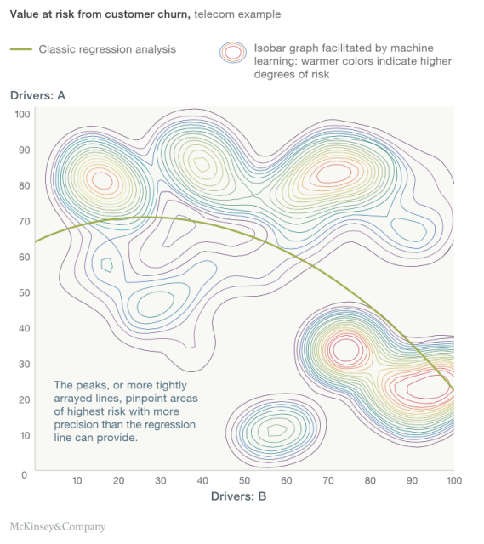
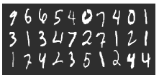

Machine Learning vs. Statistical Modeling
Machine Learning is
Algorithm that can learn from the data without relying on rules-based programming
E.g.: Machine Learning predicts the output with the accuracy of 85 %
Machine Learning is from the school of computer science
Statistical Modeling is
Formalization of relationships between variables in the form of mathematical equations
E.g.: Statistical model predicts the output with the accuracy of 85 % with 90% confidence
Statistical Modeling is from the school of Statistics & Mathematics
Digit Recognizer
Hand written digits cannot be modeled mathematically using equations. Machine learning models, trained with thousands of examples classify surprisingly
Class “9”

Slide 4
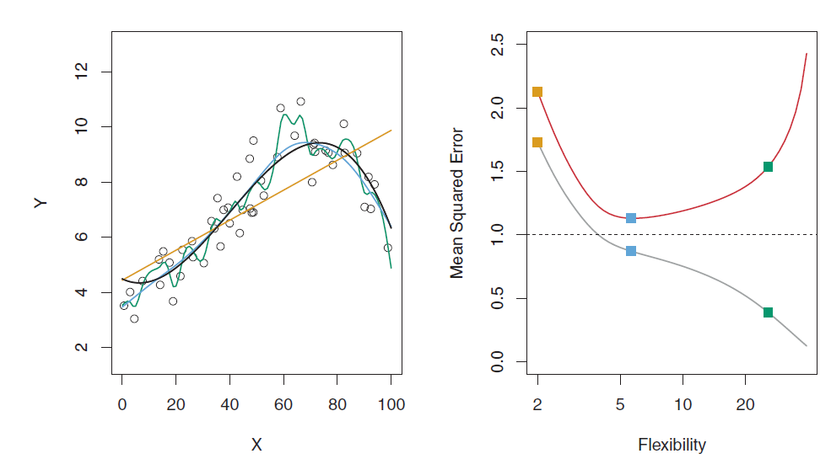
Bias vs. Variance Tradeoff
Bias vs. Variance Tradeoff
High variance model will tend to vary model’s estimate considerably even to the small change in data points
On the other hand high bias models are robust enough and do not change estimate much for the change in data points
Over fitting vs. Under fitting
High variance models (usually low bias) over fits the data
Low variance models (usually high bias) under fits the data
Bias vs. Variance Tradeoff of Model comparison
with various degrees of non linearity on Train Data
Ideal model will have both low bias & low variance
Error comparison of Train & Test datasets based on varied degree of non linearity
Tip:
1] If your model has high bias then adding more features will work (going from model degree 1 to degree 2 etc.)
2] If your model has high variance, remove features (from degree 2 to degree 1) or try to add more data will work
Model underfits if both
Train & Test errors are high

Slide 5
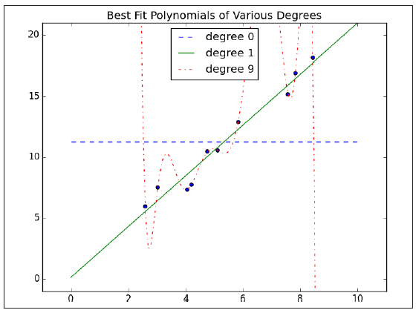
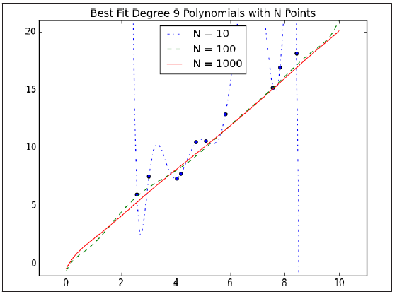
Effect of more data points on non linear models
Effect of more data
Fitting model with degree 9 on different sample sizes, it can be observed that if we train on 100 data points instead 10 data points there would be less issue of overfitting
Model trained from 1000 data points look very similar to the degree 1 model on small data of 10 data points
Effect of model non linearity on Small data
Holding model complexity constant, the more data you have, the harder it is to overfit
On the other hand, more data won’t help model with high bias
Effect of model non linearity with Degree 9 on increasing samples of data

Slide 6
Training Validation & Testing
Statistical Modeling Methodology
Training data used to train the model
Testing data used to test the accuracy of the model
Machine Learning Modeling Methodology
Train data used to train model by pairing input with expected output
Validation data used to check how well model has been trained and to estimate model properties (mean error, classification error, precision, recall etc.)
Finally calculate accuracy on Test data
Statistical Modeling Methodology
70%
30%
Train Data
Test Data
In first part you look at your model and select the best performing approach using the validation data
Then you estimate the accuracy of the model approach based on test data
Machine Learning Modeling Methodology
50%
25%
25%
Why separate Validation & Test data sets required ?
The error rate estimate of the final model on validation data will be biased (smaller than the true error rate) since the validation set is used to select the final model After assessing the final model on the test set, YOU MUST NOT tune the model any further!
Train Data
Validation Data
Test Data

Slide 7
When To Stop Tuning Model ?
Machine Learning Model Tuning
Always keep a tab on train & validation errors while tuning the algorithm
Stop increasing flexibility/degrees of the model when validation error starts increasing
Tuning of Machine Learning Models
Validation Error
Train Error
Stop Here!

Slide 8
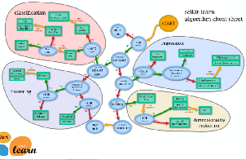
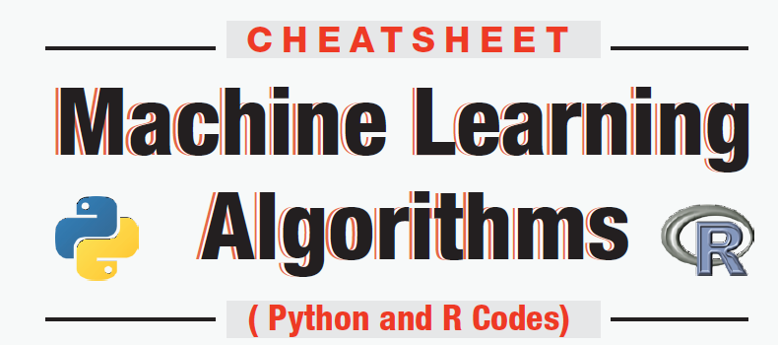
List of Machine Learning Algorithms
Supervised Learning
Unsupervised Learning
Classification/Regression
Linear Regression
Polynomial Regression
Logistic Regression
Decision Trees
Random Forest
Boosting
Support Vector Machines
KNN (K-Nearest Neighbors)
Neural Networks
Naïve Bayes
Clustering & Variable reduction
K-means clustering
PCA (Principal Component Analysis)
Supporting Techniques
Cross Validation
Gradient Descent
Grid Search

Slide 9
Cross Validation
Cross Validation
Cross validation improves the robustness of the models & provides the mean errors by averaging all possibilities as the models covers entire data points within with mix & match
Conventional Model Validation
Train Data
Test Data
70%
30%
5 Fold Cross Validation
5 Fold CV Error
= (CV1 Error + CV2 Error+ CV3 Error+ CV4 Error+ CV5 Error) / 5
CV1
20%
80%
CV2
20%
80%
CV3
80%
20%
CV4
80%
20%
CV5
80%
20%

Slide 10
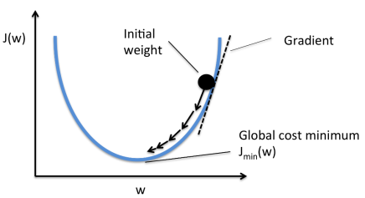
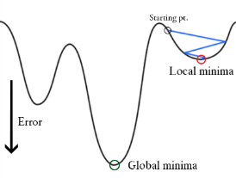
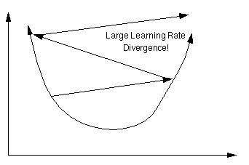
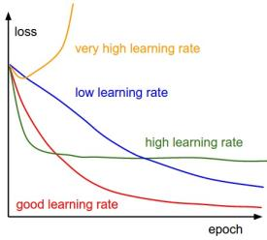
Gradient Descent
Gradient Descent
Gradient Descent (SGD): Gradient descent is a way to minimize an objective function J(θ) parameterized by a model’s parameter θ∈R^{d} by updating the parameters in the opposite direction of the gradient of the objective function w.r.to the parameters. Learning rate determines the size of steps taken to reach minimum.
Batch Gradient Descent (all training observations per each iteration)
SGD (1 observation per iteration)
Mini Batch Gradient Descent (size of about 50 training observations for each iteration)
High Learning Rate cause Divergence
Loss minimization w.r.to Learning rate
Non Convex Function

Slide 11
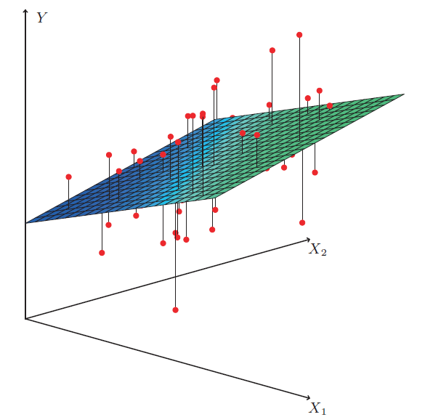
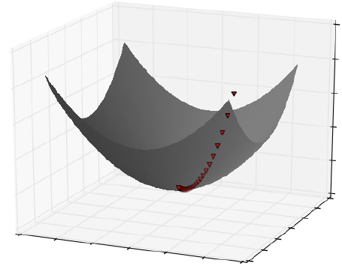


Linear Regression
Statistical way
Machine learning way
Statistical Multiple Linear Regression Assumptions
Independent variable Y should be a linear combination of dependent variables (X1, X2 …)
Multivariate normality
No or little multi-collinearity
No auto-correlation
Homoscedasticity (Errors should have constant variance)
ε
β₂
For Machine learning no assumptions are required, if model fits well, it should be able to generate high accuracy
β₁
$$\hat{Y}=β1 ∗X1+β2 ∗X2$$
$$ε={(Y −(β1 ∗X1+β2 ∗X2)) }^{2}$$

Slide 12


Linear Regression
Statistical way
Machine learning way
ε
$$\hat{Y}=β1 ∗X1+β2 ∗X2$$
β₂
$$ε={(Y −(β1 ∗X1+β2 ∗X2)) }^{2}$$
β₁
import matplotlib.pyplot as plt , import numpy as np
from sklearn import linear_model
x_train,x_test,y_train,y_test =
train_test_split( data.data, data.target )
regr = linear_model.LinearRegression ( )
regr.fit ( x_train, y_train )
print("Mean squared error: %.2f" %
np.mean (( regr.predict ( x_test ) - y_test ) ** 2))
from sklearn.linear_model import SGDRegressor
from sklearn.cross_validation import cross_val_score
from sklearn.cross_validation import train_test_split
x_train,x_test,y_train,y_test =
train_test_split( data.data, data.target )
regressor = SGDRegressor(loss= ‘squared_loss‘ )
regressor.fit ( x_train, y_train )
regressor.predict ( x_test )
print("Mean squared error: %.2f" %
np.mean ((regressor.predict ( x_test ) - y_test ) ** 2))

Slide 13
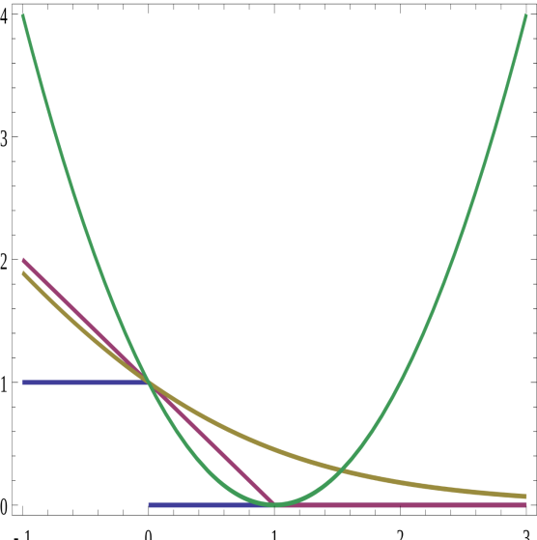

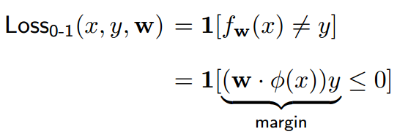
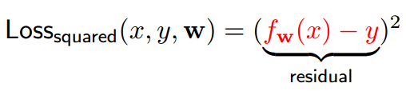

Various Losses in Machine Learning
Loss Functions in Machine Learning Models
Surrogate Losses in place of 0-1 Loss
0-1 Loss is not differentiable, hence approximated losses are being using in place
Squared loss (For regression)
Hinge Loss (SVM)
Logistic Loss/ Log Loss (Logistic Regression)
0-1 Loss
Square Loss
Log Loss
Hinge Loss
Note that all surrogates give a loss penalty of 1 for y*f(x) = 0

Slide 14
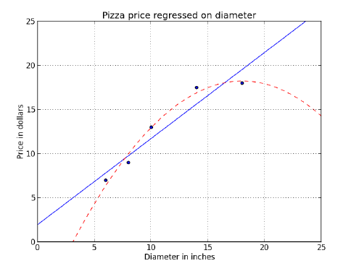

Polynomial Regression
Polynomial Regression
Polynomial Regression
Polynomial Regression is a special case of Linear Regression that adds terms with degrees greater than one to the model
Real-world curvilinear relationship is captured when you transform the training data by adding polynomial terms, which are then fit in the same manner as in multiple linear regression
Linear
Polynomial
from sklearn.linear_model import Linear_Regression
regressor = LinearRegression ( )
regressor.fit( x_train, y_train)
print("Mean squared error: %.2f" %
np.mean ((regressor.predict ( x_test ) - y_test ) ** 2))
from sklearn.preprocessing import PolynomialFeatures
from sklearn.linear_model import Linear_Regression
quadratic_featurizer = PolynomialFeatures (degree = 2 )
x_train_quadratic = quadratic_featurizer.fit_transform( x_train )
x_test_quadratic = quadratic_featurizer.fit_transform( x_test )
regressor_quadratic = LinearRegression ( )
regressor_quadratic.fit(x_train_quadratic , y_train)
print("Mean squared error: %.2f" %
np.mean ((regressor_quadratic.predict (x_test_quadratic ) - y_test ) ** 2))

Slide 15
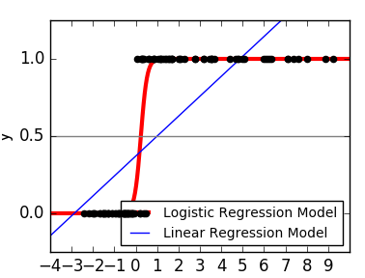

Logistic Regression
Logistic vs. Linear Regression Model on Binary data
Logistic Regression
In logistic regression response variable describes the probability that the outcome is the positive case. If the response variable is equal to or exceeds a discrimination threshold, the positive class is predicted; otherwise, the negative class is predicted
Response variable is modeled as a function of a linear combination of the explanatory variables using the logistic function.
from sklearn.linear_model.logistic import LogisticRegression
classifier = LogisticRegression()
classifier.fit (x_train,y_train)
prediction_probabilities = classifier.predict_proba (x_test)
prediction_class = classifier.predict (x_test)
from sklearn.linear_model import SGDClassifier
from sklearn.cross_validation import train_test_split
x_train,x_test,y_train,y_test =
train_test_split( data.data, data.target )
classifier = SGDClassifier (loss= ‘log‘ )
classifier.fit ( x_train, y_train )
prediction_probabilities = classifier.predict_proba (x_test)
prediction_class = classifier.predict (x_test)

Slide 16
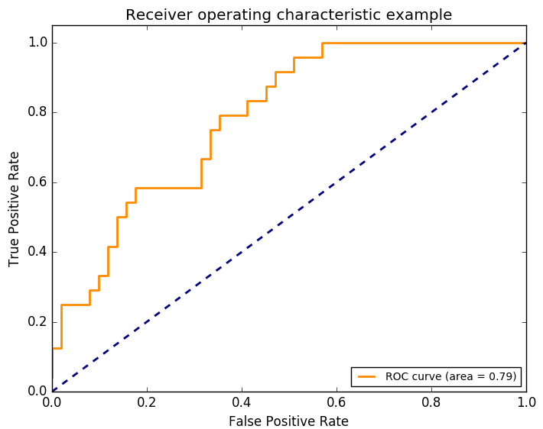
Logistic Regression
ROC Curve
ROC Curve
ROC curves provide the goodness of model, higher the area under curve, the better the model is
Accuracy = (TP+TN) / N
Precision = TP / (TP+FP)
Recall = TP / (TP+FN)
F1 score = 2 * P * R / (P+R)
Sensitivity = TPR = Recall = TP / (TP+FN)
1- Specifity = FPR = FP / (FP+TN)
from sklearn.metrics import roc_curve,auc
from sklearn.cross_validation import cross_val_score
classifier = LogisticRegression()
classifier.fit (x_train,y_train)
tscores = cross_val_score( classifier, x_test, y_test, cv=5)
Print ('Test Accuracy :',np.mean(tscores),tscores)
tprecisions = cross_val_score(classifier, x_test, y_test, cv=5, scoring='precision')
print('Test Precisions:',np.mean(tprecisions),tprecisions)
trecalls = cross_val_score(classifier, x_test, y_test, cv=5, scoring=‘recall')
print('Test Recalls:', np.mean(tprecisions),trecalls)
false_positive_rate,recall,thresholds = roc_curve ( y_test, predictions )
roc_auc = auc ( false_positive_rate, recall )

Slide 17
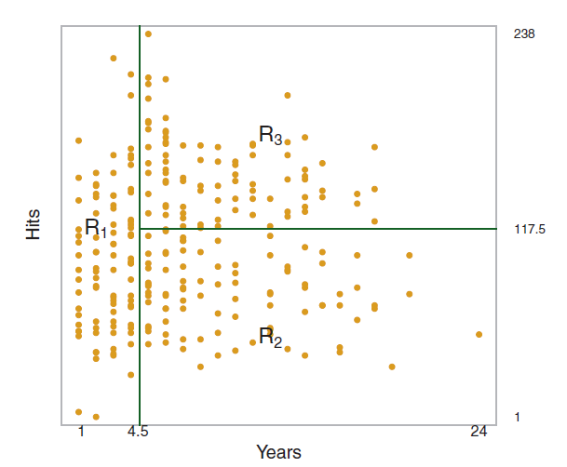
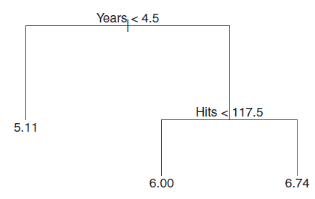
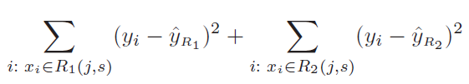
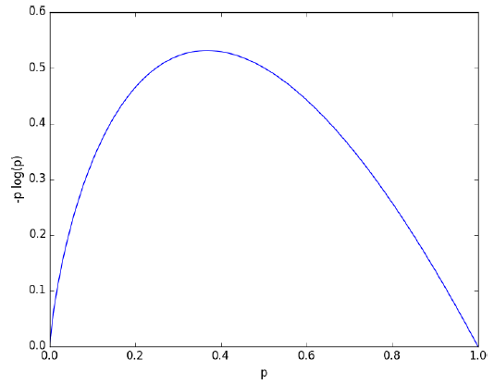
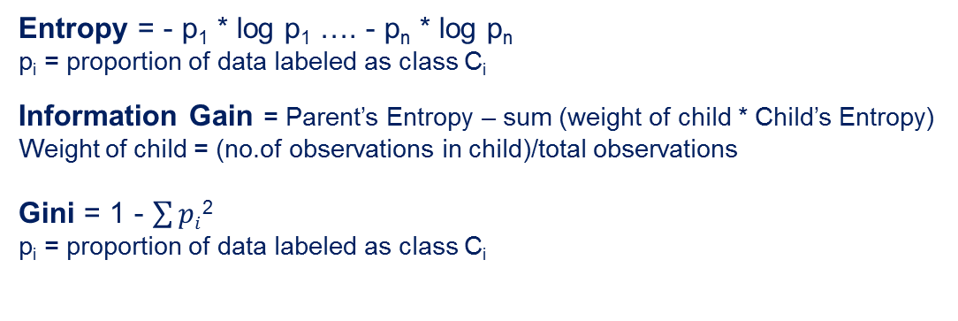
Decision Trees
What is Decision Tree ?
Decision tree uses a tree structure to represent a number of possible decision paths and an outcome for each path
Decision Trees can be applied to both classification & regression problems
Regression Tree for Predicting Log salary of Baseball Players
Classification
Criteria:
1] Entropy, Information Gain
2] Gini
Regression
Criteria:
1] Mean Square Error
Entropy = - p₁ * log p₁ …. - p_{n} * log p_{n}
p_{i} = proportion of data labeled as class C_{i}
Information Gain = Parent’s Entropy – sum (weight of child * Child’s Entropy)
Weight of child = (no.of observations in child)/total observations
Gini = 1 - $\sum{pi}$²
p_{i} = proportion of data labeled as class C_{i}
Entropy

Slide 18
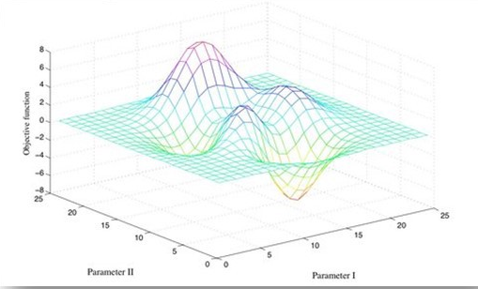
Decision Trees – Grid Search
Grid Search - Classification Tree
Regression Tree
from sklearn.tree import DecisionTreeClassifier
from sklearn.pipeline import Pipeline
from sklearn.grid_search import GridSearchCV
pipeline = Pipeline([
(‘ clf ', DecisionTreeClassifier(criterion='entropy')) ])
parameters = {
'clf__max_depth': (150, 155, 160),
'clf__min_samples_split': (1, 2, 3),
'clf__min_samples_leaf': (1, 2, 3)
}
grid_search = GridSearchCV(pipeline, parameters, n_jobs=-1, verbose=1, scoring='f1')
grid_search.fit (x_train, y_train)
predictions = grid_search.predict (x_test)
best_parameters = grid_search . best_estimator_ . get_params ( )
for param_name in sorted ( parameters.keys ( ) ):
print ('\t%s: %r' % (param_name, best_parameters[param_name]))
from sklearn.tree import DecisionTreeRegressor
pipeline = Pipeline([
(‘ clf ', DecisionTreeClassifier(criterion=‘mse')) ])
Grid Search

Slide 19
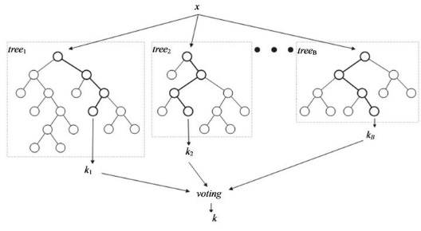
Random Forest
Random Forest
Random forest is a collection of decision trees that have been trained on randomly selected subsets of the training instances and explanatory variables
Random forests usually make predictions by returning the mode or mean of the predictions of their constituent trees
Random forests are less prone to overfitting than decision trees because no single tree can learn from all of the instances and explanatory variables; no single tree can memorize all of the noise in the representation
Bagging
(Bootstrap Aggregation)
Random Forest
Random Forest Classifier
Each tree is trained on roughly 2/3 observations/training instances
No.of explanatory variables = p
Classification trees - Sqrt (p)
Regression trees – p / 3

Slide 20
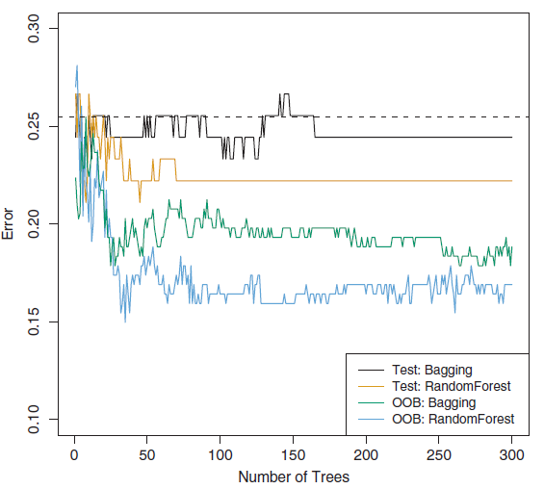
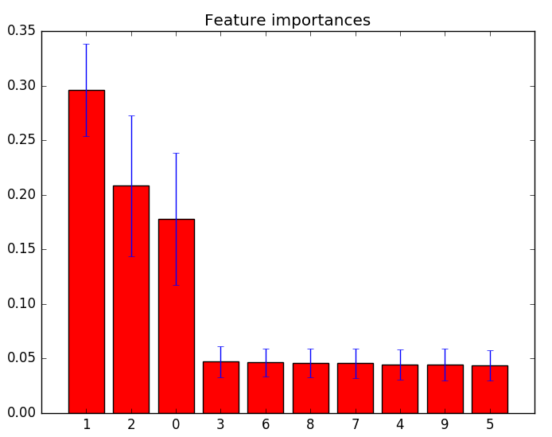
Random Forest
Bagging vs. RandomForest
Grid Search – RandomForest Classifier
from sklearn.ensemble import RandomForestClassifier
from sklearn.pipeline import Pipeline
from sklearn.grid_search import GridSearchCV
pipeline = Pipeline([
(‘ clf ', RandomForestClassifier(criterion='entropy‘, max_features=‘auto')) ])
parameters = {
'clf__n_estimators': (5, 10, 20 , 50),
'clf__max_depth': (150, 155, 160),
'clf__min_samples_split': (1, 2, 3),
'clf__min_samples_leaf': (1, 2, 3)
}
grid_search = GridSearchCV(pipeline, parameters, n_jobs=-1, verbose=1, scoring='f1')
grid_search.fit (x_train, y_train)
predictions = grid_search.predict (x_test)
best_parameters = grid_search . best_estimator_ . get_params ( )
for param_name in sorted ( parameters.keys ( ) ):
print ('\t%s: %r' % (param_name, best_parameters[param_name]))
importances = grid_search.feature_importances_

Slide 21
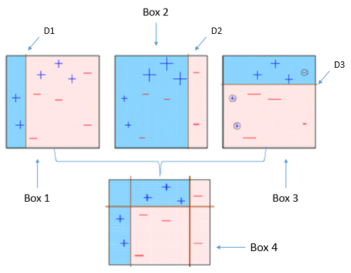
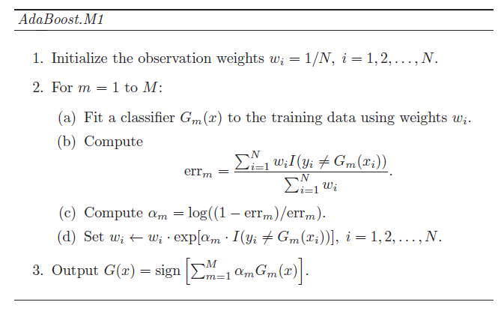
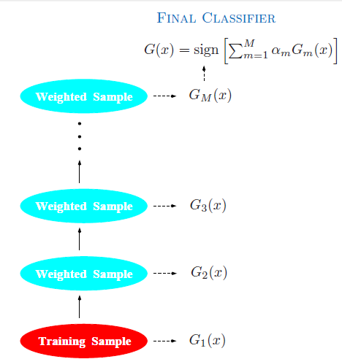
Boosting
Boosting
Boosting refers to a family of algorithms which converts weak learner to strong learners
Steps in Boosting
Step 1: Assign equal weights to all observations (E.g.: 1/N where N is No.of observations)
Step 2: If there is any prediction error caused by first base learning algorithm, then we pay higher attention to observations having prediction error. Then, we apply the next base learning algorithm
Step 3: Iterate Step 2 till the no.of models limit is reached or higher accuracy is reached
Finally, it combines the outputs from weak learner and creates a strong learner by taking a weighted mean of all boundaries discovered
Boosting Algorithm (Adaboost)

Slide 22
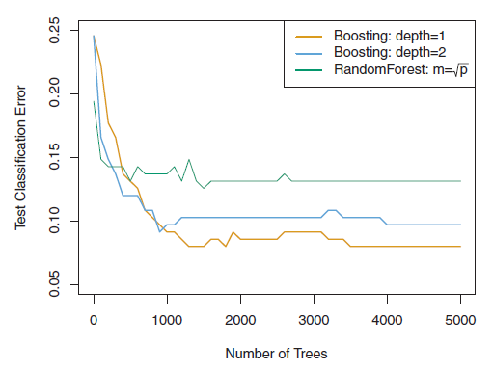
Boosting
Grid Search - AdaBoost Classifier
Boosting vs. Random Forest
from sklearn.ensemble import AdaBoostClassifier
from sklearn.pipeline import Pipeline
from sklearn.grid_search import GridSearchCV
pipeline = Pipeline([
(‘ clf ', AdaBoostClassifier( base_estimator = DecisionTreeClassifier(max_depth=1),
algorithm = ”SAMME.R” ))
])
parameters = {
'clf__n_estimators': (50, 100, 200 , 500),
'clf__learning_rate': (0.1, 0.5, 1),
}
grid_search = GridSearchCV(pipeline, parameters, n_jobs=-1, verbose=1, scoring='accuracy')
grid_search.fit (x_train, y_train)
predictions = grid_search.predict (x_test)
best_parameters = grid_search . best_estimator_ . get_params ( )

Slide 23


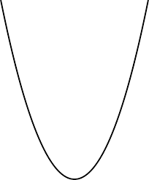
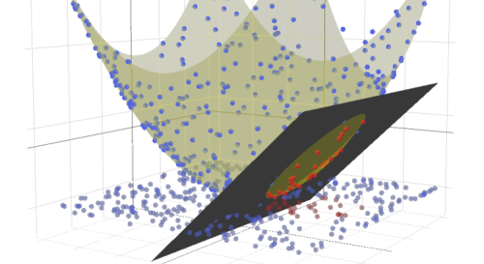
Support Vector Machines
Support Vector Machines
Support Vector Machine maximizes the margin between different classes
When the data is not linearly separable, SVMs use the “Kernel Trick” to map data to higher dimensions using Kernel Matrices
A Kernel Matrix is the inner product of the mapping of the data points
Support Vector Machines
x₂
x₂
margin
x₁
x₁
Kernel trick on 2D example
x²
x
1D example of Linearly
Inseparable Case
Application of Kernel Trick
on 1D data
Train Error
x
After moving to
higher dimensions, data will
be Linearly Separable

Slide 24
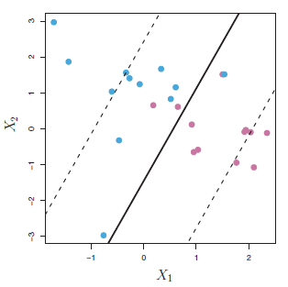
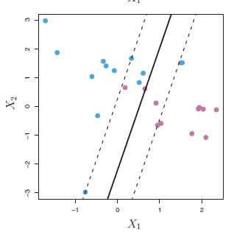
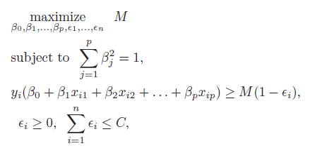
Support Vector Machines
Support Vector Classifier
Impact of Cost on Margins
from sklearn.svm import SVC
from sklearn.pipeline import Pipeline
from sklearn.grid_search import GridSearchCV
pipeline = Pipeline([
(‘ clf ', SVC ( kernel = ’rbf‘))
])
parameters = {
'clf__gamma': (0.001, 0.03, 0.1 , 0.3 , 1 ),
'clf__C': ( 0.1, 0.3, 1 , 3, 10 , 30 )
}
grid_search = GridSearchCV(pipeline, parameters, n_jobs=-1, verbose=1, scoring='accuracy')
grid_search.fit (x_train, y_train)
predictions = grid_search.predict (x_test)
best_parameters = grid_search . best_estimator_ . get_params ( )
Margins will be closer as cost of violations C decreases
i.e. variance increases with the decrease in cost

Slide 25
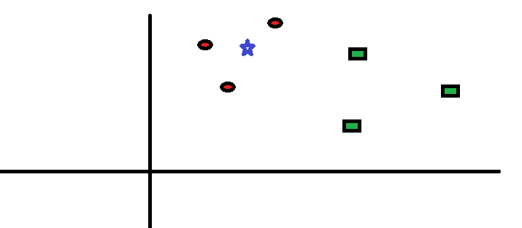
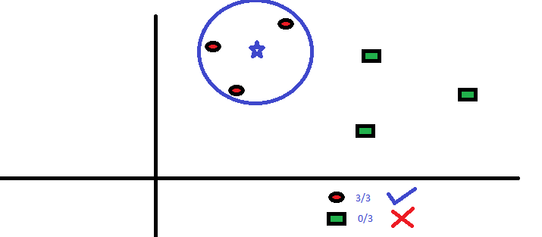
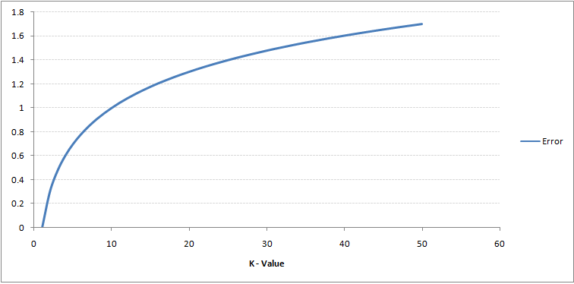
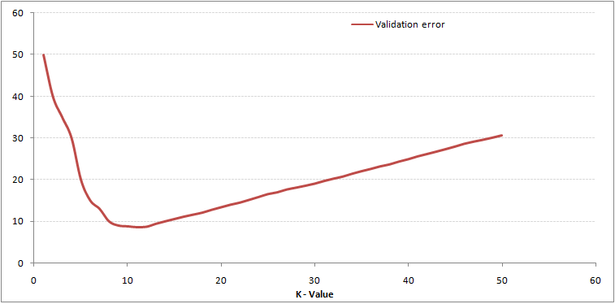
K Nearest Neighbors
K Nearest Neighbors
K Nearest neighbors is one of the simplest predictive models. It makes no mathematical assumptions, and it doesn’t require any sort of heavy machinery. The only things it requires are:
Some notion of distance
An assumption that points that are close to one another are similar
K Nearest Neighbors
from sklearn import neighbors
knn = neighbors.KNeighborsClassifier ( n_neighbors = 3)
knn.fit (x_train, y_train)
predicted = knn.predict (x_test)
K Nearest Neighbors (K=3)
Training Error
Validation Error

Slide 26
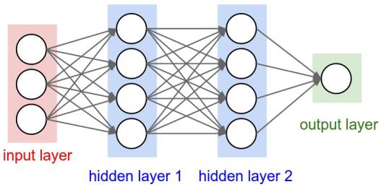
Neural Networks
Neural Networks
Neural networks are analogous to human brain
Two hidden Layer MLP (Multi Layer Perceptron) Neural Network
from sklearn.neural_network import MLPClassifier
from sklearn.preprocessing import StandardScaler
clf = MLPClassifier( activation =‘relu', solver=‘lbfgs', alpha =1e-5,
hidden_layer_sizes =(5, 2), max_iter = 200, random_state =1)
scaler = StandardScaler ( )
scaler.fit (x_train)
x_train = scaler.transform (x_train)
x_test = scaler.transform (x_test)
clf.fit (x_train, y_train)
clf.predict (x_test)
print [coef.shape for coef in clf.coefs_ ]
[(2, 5), (5, 2), (2, 1)]
Sample x, y
x = [[0., 0.], [1., 1.]]
y = [[0, 1], [1, 1]]

Slide 27
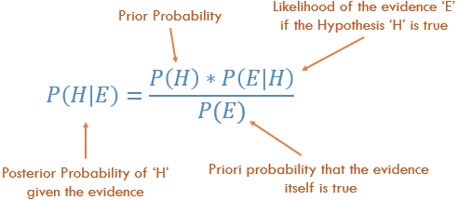


Naïve Bayes
Bayes Theorem
Naïve Bayes
Naive Bayes methods are a set of supervised learning algorithms based on applying Bayes’ theorem with the “naive” assumption of independence between every pair of features
from sklearn.naive_bayes import GaussianNB
clf = GaussianNB ( )
clf.fit ( x_train, y_train )
predict = clf.predict (x_test)
What is the probability of email is spam when following words appear ?
Lottery = yes, Money = no, Groceries = no, Unsubscribe = yes
Intersection operations on words are expensive, a naïve independence assumption improves Computational efficiency, yet effective in providing results

Slide 28
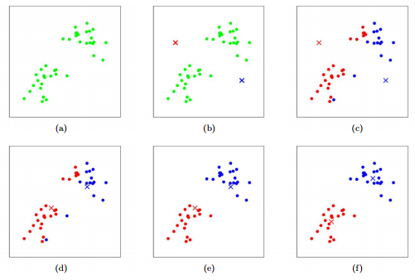
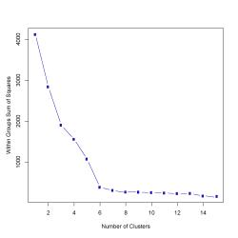
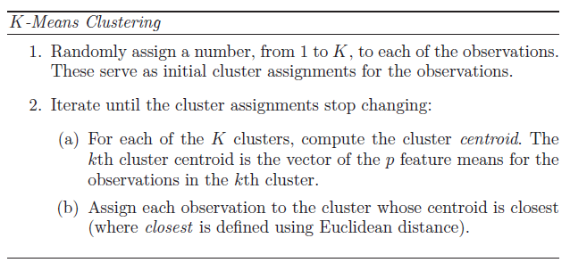
K means Clustering
K means clustering
K-Means is an iterative process of moving the centers of the clusters, or the centroids, to the mean position of their constituent points, and re-assigning instances to their closest clusters
K Means Clustering
from sklearn.cluster import Kmeans
import numpy as np
import matplotlib.pyplot as plt
from scipy.spatial.distance import cdist
K = range(1,10)
meandistortions = []
for k in K:
kmeans = Kmeans (n_clusters=k)
kmeans.fit (x)
meandistortions.append (sum( np.min (cdist
(x, kmeans.cluster_centers_, ‘ euclidean ') ,axis=1)) / x.shape [0] )
plt.plot (K,meandistortions,'bx-')
Elbow plot

Slide 29
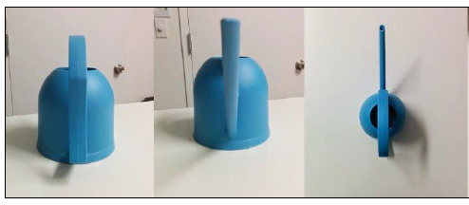
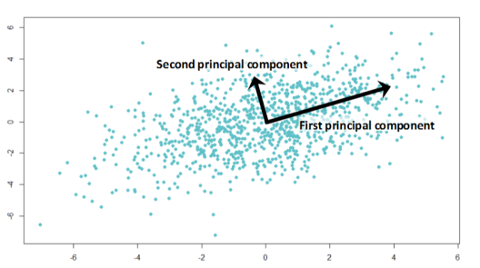
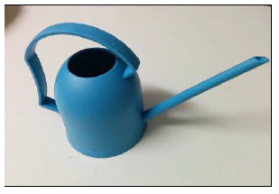
Principal Component Analysis
Various dimensions of Watering Can
Principal Component Analysis
PCA reduces the dimensions of a data set by projecting the data onto a lower-dimensional subspace
PCA reduces a set of possibly-correlated, high-dimensional variables to a lower-dimensional set of linearly uncorrelated synthetic variables called principal components
lower-dimensional data will preserve as much of the variance of the original data as possible
PCA with orthogonal rotation on 2D Data
Watering Can seen from Principal Component
(Direction of Maximum Variance)

Slide 30
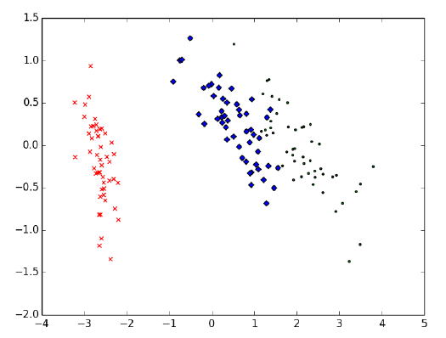
Principal Component Analysis
2D representation of original 4D IRIS data
from sklearn.decomposition import PCA
from sklearn.datasets import load_iris
data = load_iris( )
y = data.target
x = data.data
pca = PCA ( n_components = 2 )
reduced_x = pca.fit_transform ( x )
PC2
PC1

Slide 31
Thank You

